Slide 1
Specifying Criteria in Query Design View

Slide 2
Queries – Different Types
Select
Make Table
Append
Update
CrossTab
Delete

Slide 3
Queries Notice that Access is fairly flexible as to the kind of notation it will accept from the user. In most cases, it will automatically adjust the user’s typed-in criteria, by automatically including its own special notation characters such as double quotes around pieces of text values, and pound signs around date values.
User’s Typed-in Value After Access Converts It
Ontario “Ontario”
“Ontario” “Ontario”
= Ontario = “Ontario”
= “Ontario” = “Ontario”
25-Dec-2011 #25-Dec-2011#
=25-Dec-2011 =#25-Dec-2011#

Slide 4
Select Queries are answers to a question, not very formal…give me a sec!
Questions such as:
How many people live in Ontario
How many people line in K-W
Who’s Birthday between January and February and live in K-W

Slide 5
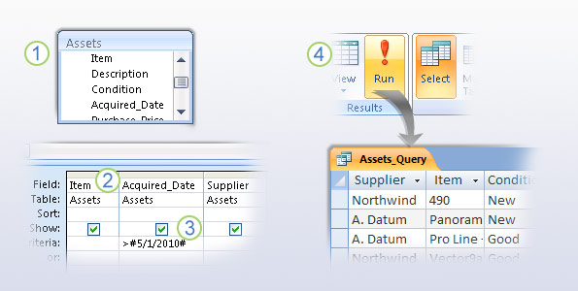

Slide 6
Select Query
❶ Start by choosing a record source for the query. A record source can be one or more tables, one or more queries, or a combination of the two. The picture shows a table open in the Query Designer.
❷ From the record source, select the fields that you want to see in the query. The picture shows fields in the Query Designer, but you do the same thing in the Query Wizard.

Slide 7
Select Query
❸ Add any sorting, filtering, or other selection criteria to your queries. For example, if you use the criteria shown in the picture, the query will only return data for assets purchased after May First of 2010.
❹ After you finish adding fields and any selection criteria, run your query to see if it gives you the correct results.

Slide 8
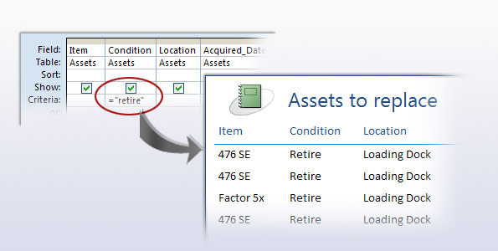
Running the Select Query
When you run a select query, Access displays the results in a datasheet.
The result is called a record set, and you can work with it in the same way that you work with a datasheet.
For example, you can add or change data, and Access will write your changes to the tables that serve as the record sources for your query

Slide 9
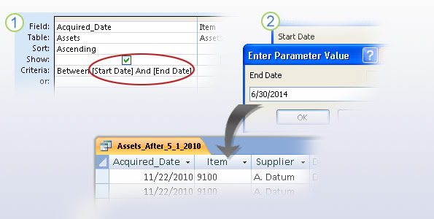
Make a Query ask for Input
The type of query that you created in the previous section can return a lot of data. A common way to limit what the query returns is to use a parameter.
Put simply, parameters make the query ask for input before it runs; they are a type of filter that you build into your query.

Slide 10
Finding Exact Matches
= 100 Finds records that have the field value of 100.
= Ontario Finds records that have the field value of Ontario.
= 25-Dec-2015 Finds records that have this specific date of Dec 25, 2015.
Note – Access will “correctly interpret” many notations for providing Date criteria (such as the use of slashes, dashes, commas, etc.)
However, be aware of your computer’s settings for handling Dates (found in the Windows Control Panel under the Region and Language feature), so that your dates will be interpreted correctly.

Slide 11
Using Relational Operators:
< 100 Finds records where that value is less than 100.
< N Finds text starting with the letters A through M (Note – this is not case sensitive).
< 25/Dec/2015 Finds dates before Dec 25, 2015.

Slide 12
Using Relational Operators:
< 100 Finds records where that value is less than 100.
< N Finds text starting with the letters A through M (Note – this is not case sensitive).
< 25/Dec/2015 Finds dates before Dec 25, 2015.
<= 100 Finds records where that value is less than or equal to 100.
<= N Finds text starting with the letters A through M, and including the letter N.
<= 25/Dec/2011 Finds dates before, or on Dec 25, 2011.
>100 Finds records where that value is greater than 100.
>= 100 Finds records where that value is greater than or equal to 100.
>= N Finds text starting with (and including) the letter N up to and including Z.

Slide 13
Using the Not Equal To Operator:
Is Null Finds records that do not contain data in that field (ie. that field is empty).
Is Not Null Finds records that do contain data in that field.

Slide 14
Checking for Values within a List of Items:
In (100, 101, 102) Finds records that have any of these values in that field.
In (Ontario, ON) Finds records that have either one of these notations in that field.
In (S, XL) Finds records that have any of these values in that field (eg. but not M, L, or any others).
In (#25/Dec/2011#, #31/Dec/2011#) Finds records where the date is either one of these two dates. Impt – when using In you must provide the # signs to the left and right of each date criteria.
Kitchener Or Waterloo Finds records that have either one of these notations in that field.
Not Kitchener Finds all records except those records where the notation is Kitchener.

Slide 15
Checking for a Range of Values:
Between 100 And 200 Finds records whose value is between 100 and 200 inclusive.
Between M And T Finds text starting with the letters from M to T inclusive.
Between 25/Dec/2015 And 31/Dec/2015 Finds dates between those two dates inclusive. Note – in this case, Access will automatically insert the # signs to the left and right of each date.

Slide 16
Using Wildcards:
The asterisk (*) wildcard represents one or more characters. The question mark (?) wildcard represents just a single character.
Like Wat* Finds text starting with Wat, such as Waterloo, Waterdown, Watford, Waterford.
Like *ay* Finds text containing ay, such as Aylmer, Bayfield, Mildmay, Drayton.
Like Patt? Finds text containing Patt and one other letter in fifth spot, such as Patty, Patti.
Like L?nda Finds text containing L nda and any letter in second spot, such as Linda, Lynda.
Like “[A-M]*” Finds text that begins with A through M, and ends in anything (and with any number of characters) eg. Al, Amanda, Joe, Joan, Meg, Margaret.

Slide 17
Finding Exact Matches that include And :
“Bacon and Eggs”
When specifying criteria where you looking for an exact match (ie. That includes the word and ) so that Access does not treat the and as a Logical operator, you must surround the entire expression that you are checking for, with quotation marks.

Slide 18
Using Date-Related Criteria:
Note #1 – you would type the following criteria expressions into a field cell that is storing a Date type value.
Note #2 – for some of the slides, assume that the OrderDate field is storing 25-Dec-2015.

Slide 19
Using Date-Related Criteria:
Date() Finds records that are storing the current date.
Date() – 365 Finds records from exactly 1 year ago today (ie. on just that single day).
Between Date() AND Date() – 365 Finds records anytime within the last year.
Between Date() AND Date() – 30 Finds records within the last thirty days.
Between #25-Dec-2015# AND #31-Dec-2015# Finds records between those two dates inclusive.
Day([OrderDate]) = 15 Finds records where the order date occurs on the 15th day of the month.
Weekday([OrderDate]) = 2 Finds records where the order date occurs on the 2nd day of the week (ie. Monday).
Month([OrderDate]) = 8 Finds records where the order date occurs during the 8th month (ie. August).
Year([OrderDate]) = 2015 Finds records where the order date occurs during the year 2015.

Slide 20
Using Date-Related Criteria:
DatePart(Interval, Date) Using this DatePart function, by specifying the Interval argument, you can customize the type of information you want to extract from a Date type of value. DatePart(“m”,[OrderDate]) = 8 Finds records occurring during the 8th month (ie. August). DatePart(“yyyy”,[OrderDate]) = 2015 Finds records occurring in the year 2015. The other possible choices for the Interval argument are as follows: DatePart(“d”,[OrderDate]) = 25 Finds records occurring on the 25th of the month. DatePart(“y”,[OrderDate]) = 90 Finds records occurring on the 90th day of the year. DatePart(“w”,[OrderDate]) = 2 Finds records occurring on a Monday. DatePart(“ww”,[OrderDate]) = 47 Finds records occurring during the 47th week of the year. DatePart(“q”,[OrderDate]) = 3 Finds records occurring during the 3rd quarter of the year. DatePart(“h”,[OrderDate]) = 14 Finds records occurring during the 14th hour of the day. DatePart(“n”,[OrderDate]) = 45 Finds records occurring at the 45 minute mark. DatePart(“s”,[OrderDate]) = 15 Finds records occurring at the 15 second mark.

Slide 21
Make a query ask for input
Here’s how to use parameters in your queries:
❶ Open the query in Design view, and in the Criteria row of the field you want to filter, enter your parameter. For example, you can use the criteria shown in the picture.
❷ When you run the query, that criteria asks you for a start date, then an end date, and it returns only the records that fall within the dates you specify.

Slide 22
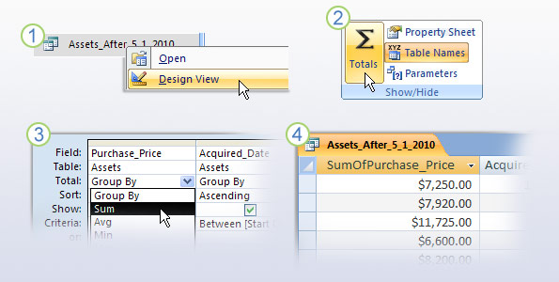
Use a formula in a query
Another common way to alter the selection criteria in a query is to add a function.
For example, if you want to know how much your company spent on office furniture last year, you can add an aggregate function to the query and the sum will appear in your results.
❶Open your query in Design view.
❸ In the field where you want to use the function, click the Total row and select a function from the list.
❷ On the Design tab, in the Show/Hide group, click Totals. The Total row appears in the designer.
❹ When you run your query, the results include your calculation.

Slide 23
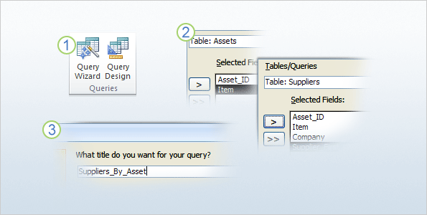
Query multiple record sources
You can use multiple tables, or other queries, as the record source for a new query. In fact, you’ll query multiple record sources far more than you will single sources. Multi-source queries are how you answer questions such as which assets came from which suppliers.
The Query Wizard is the easiest way to get started building multi-source queries, especially if you’re new to Access.

Slide 24
Query multiple record sources
❶On the Create tab, in the Queries group, click Query Wizard.
❷ Complete the wizard. As part of that process, select the tables and fields you want to use as your record source, and…
❸ Give your new query a descriptive name, and remember to avoid using spaces in the name.

Slide 25
Links Cross Tab https://www.youtube.com/watch?v=0v-ILGUtGFo Append Query https://www.youtube.com/watch?v=-9PO1DDDP50 Update Query https://www.youtube.com/watch?v=Sh3r8VaBdf4

